Slide 1
Lesson 13 Sign test Interactive Seminar E214 – Statistical Methods for Engineering

Slide 2
Pre-Lesson Activity
Pre-Lesson class discussion.
Ensure that you have read the pre-reading before each lesson!
2

Slide 3
Pre-Lesson Activity
[Class Discussion & Sharing]
3

Slide 4
E214 – Statistical Methods for Engineering
Inferential Statistics
Hypothesis Testing
Parameter Estimation
Organize & summarize data collected
Probability and Distributions
Venn Diagram
Discrete Random Variables and Probability Distributions
Probability Distributions
Descriptive Statistics
Continuous Random Variables and Probability Distributions
Binomial Distribution
Poisson Distribution
Normal Distribution
Exponential Distribution
Tree Diagram
L13
A more detailed topic tree on Hypothesis Testing will be given from P08 onwards

Slide 5
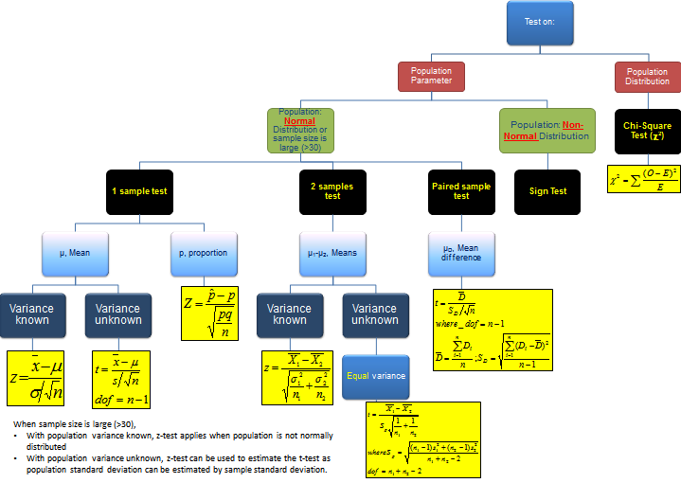
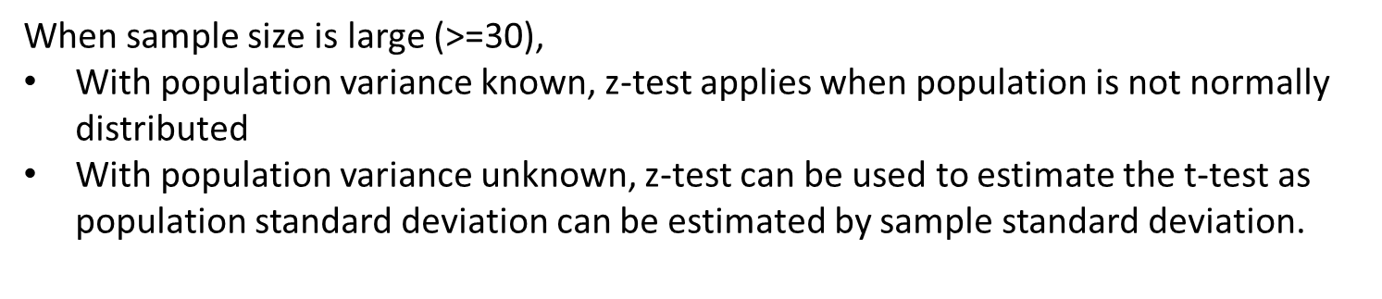
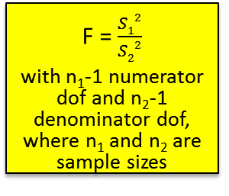
Topic Tree for Hypothesis Testing
ANOVA
A tool to compare the means of several (3 or more) populations with a single test.
L13
2 samples test on variance
σ₁² – σ₂²
F = $\frac{S12}{S22}$
with n₁-1 numerator dof and n₂-1 denominator dof, where n₁ and n₂ are sample sizes
5

Slide 6


Scenario
A research staff at Republic Polytechnic wishes to conduct some study on the travelling time of students between home and campus.
Based on feedback from lecturers, one common reason students stated for being late for class is long travelling time from home to campus. To validate the feedback, the research staff wishes to test whether the median travelling duration by students from their home to campus in the morning is longer than 45 minutes.

Slide 7
Scenario
The research staff also wishes to study whether students’ travelling time from home to school in the morning is the same as the time they take to travel from school to home in the afternoon.
After chatting with some students, most of them claimed that the time taken to travel from home to school in the morning is longer than the time taken to travel from school to home in the afternoon. The research staff wishes to validate this claim.
Help the researcher by carrying out a survey in your class to collect relevant data and conducting suitable tests.

Slide 8
Class Discussion on scenario
From the scenario:
How many tests need to be conducted? What is the parameter of interest for each test?
What are the data to be collected for each test?
Can we assume that the data collected follow a normal distribution?
If yes, what parametric tests are applicable?
If not, what type of tests are applicable?

Slide 9
Class activity
Collect the data from your classmates needed for the two tests in the scenario.
You may use the template provided below to help you with the activity.

Slide 10
Non-parametric Tests
Statistical tests such as z, t and F tests are called parametric tests, which require the assumption that the populations where the samples are drawn are normally distributed
Parametric tests are based on a particular parametric family of distributions – in this case, the normal distribution.
In situations where the population distribution is not normal, nonparametric (or distribution-free) tests can be used.
Generally, a parametric inference approach is based on a distributional assumption for data observations; whereas a nonparametric inference approach provides answers that are not based on any distributional assumptions (distribution-free).

Slide 11
Pros and Cons of Non-parametric Tests
Advantages
Disadvantages
Populations from which samples are drawn need not be normally distributed
Can be used to test hypotheses that do not involve population parameters, such as randomness of sample, relationship between 2 samples
Computations are generally easier compared to parametric tests
Less sensitive than parametric tests when the normality assumption is met. Thus, larger differences are needed before the null hypothesis can be rejected.
Less efficient in the sense that a larger sample size is required to overcome loss of information

Slide 12
The Sign Test
There are many non-parametric tests available, such as the sign test, Wilcoxon signed-rank test, Wilcoxon rank-sum test, Kruskal-Wallis test etc. We will be covering only the sign test for this module.
The sign test is a basic non-parametric hypothesis testing procedure that can be used to test the value of the population median.
It provides an alternative to either the single-sample t-test or the paired t-test.
It can be used for small sample sizes.
The sign test is carried out by assigning a ‘+’ to sample values above the hypothesized median value and a ‘-’ to sample values below the hypothesized median value.
It does NOT account for the magnitude of the difference between values in the data and the median.
To use the sign test, we do not need to make any assumption of the population distribution being normal.

Slide 13

Procedures in conducting the Sign Test
State H₀ (Null) & H₁ (Alternative) hypotheses
and significance level α
Why is Binomial Distribution Used?
Let X denote the number of positive signs out of a random sample of n signs (“0” signs are discarded).
We can see that X can only take on a finite number of possible values: 0, 1, 2, …, n. Furthermore, each trial can have only two possible outcomes: “+” and “-” signs and the trials are independent of one another.
Also, if $H_{0}$ is true (i.e. value stated in $H_{0}$ is really the median), then
50% of the signs in the sample should be positive (i.e. p = 0.5).
So, X~B(n, 0.5)
For single-sample test:
Compare each value with the hypothesized median. If value is larger, replace with ‘+’ sign.
If smaller, replace with ‘-’ sign.
If equal, indicate with 0 and discard the value.
For paired-sample test:
e.g. Calculate: Difference = “before value”–“after value” If value is positive, indicate with ‘+’ sign
If value is negative, indicate with ‘-’ sign
If 0, discard the ‘0’ value(s).
Get n and r
(n = total number of ‘+’ and ‘-’ signs, r = number of ‘+’ sign)
Compute the p-value based on binomial distribution with n, r and probability of success =0.5
Lower-tailed test (H1 contains “<“):
p-value = P(X<=r)
= BINOM.DIST(r,n,p,1)
For 2-tailed test:
p-value = 2 * smaller value of P(X<=r) and P(X>=r)
*Refer to pre-reading material (pg 2-3) for explanation of p-value calculation for two-tailed test
Upper-tailed test (H1 contains “>“):
p-value = P(X>=r)
= 1- BINOM.DIST(r-1,n,p,1)
If probability (p-value) < significance level α, reject H_{0.} Otherwise, do not reject H₀.
Write down a formal conclusion in the problem context.

Slide 14
Example: Single-sample Sign Test
In a laboratory experiment, 18 determinations of the coefficient of friction between leather and metal yielded the following results: 0.59, 0.56, 0.49, 0.55, 0.65, 0.55, 0.51, 0.60, 0.56, 0.47, 0.58, 0.61, 0.54, 0.68, 0.56, 0.50, 0.57 and 0.53. Use the sign test at a 5% level of significance to determine whether the median coefficient of friction is 0.55.
[Solution]
Let m denote the population median coefficient of friction.
H₀: m = 0.55
H₁: m ≠ 0.55

Slide 15
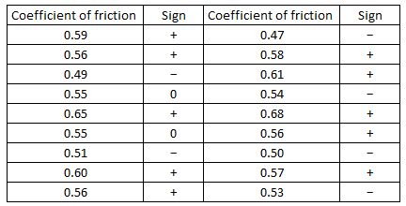
Example: Single-sample Sign Test
[Solution]
Compare the list of 18 values against the hypothesized median value of 0.55. If they are greater, we assign ‘+’ signs. If they are less, we assign ‘-’ signs and if they are equal, we assign ‘0’ signs. The signs corresponding to the list of 18 values become:

Slide 16
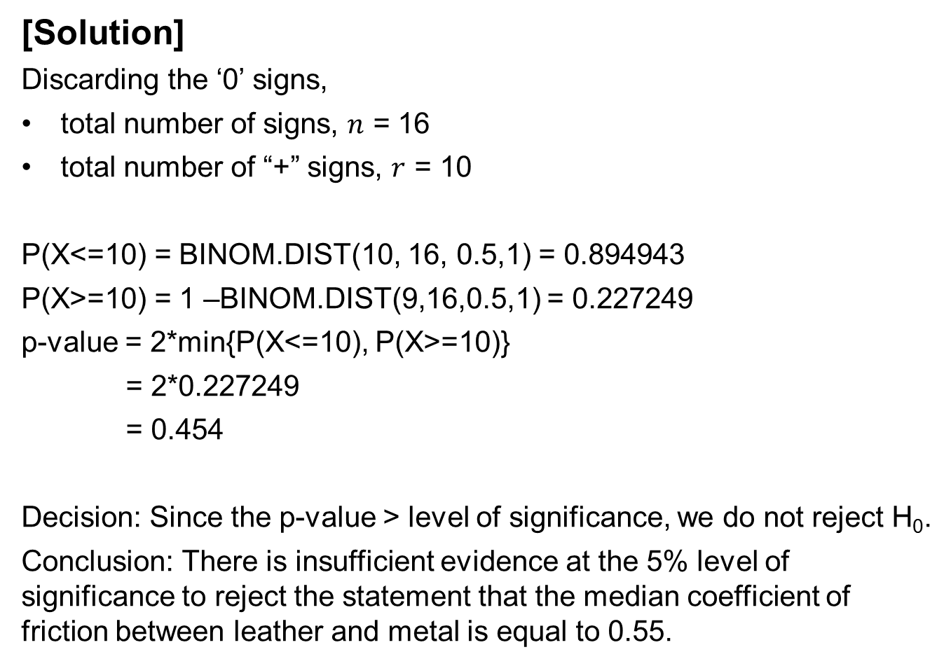
Example: Single-sample Sign Test
[Solution]
Discarding the ‘0’ signs,
total number of signs, $n$ = 16
total number of “+” signs, $r$ = 10
P(X<=10) = BINOM.DIST(10, 16, 0.5,1) = 0.894943
P(X>=10) = 1 –BINOM.DIST(9,16,0.5,1) = 0.227249
p-value = 2*min{P(X<=10), P(X>=10)}
= 2*0.227249
= 0.454
Decision: Since the p-value > level of significance, we do not reject H₀.
Conclusion: There is insufficient evidence at the 5% level of significance to reject the statement that the median coefficient of friction between leather and metal is equal to 0.55.

Slide 17
Solving Scenario Tasks (A)
[Team discussion & activity]
From the scenario given earlier (slide 6), you are to help the researcher determine whether the median travelling duration by students from their home to campus in the morning is longer than 45 minutes.
Consider the following:
State the hypotheses.
What is a suitable statistical test to conduct? What are the necessary assumptions? Decide on an appropriate level of significance.
Compute the p-value. Show all necessary working.
Can the null hypothesis be rejected? State a formal conclusion in the context of the scenario. Interpret the results.

Slide 18
Solving Scenario Tasks (A)
[Solution]

Slide 19
Solving Scenario Tasks (A)
[Solution]

Slide 20
Solving Scenario Tasks (A)
[Solution]

Slide 21
Example: Paired-sample Sign Test
The following table shows the weekly loss of worker-hours due to accidents at 13 industrial sites before and after a certain safety program was put in place. Use a 5% level of significance to test whether the safety program is effective. Assume that the distribution of weekly loss of working-hours is non-normal.
[Solution]
We test the median of the difference in loss hours before and after the program (m_{d}), therefore taking difference = weekly loss in worker hours before safety program - weekly loss in worker hours after safety program
H₀: m_{d} = 0 (safety program is not effective)
H₁: m_{d} > 0 (safety program is effective)
Before (Hours) | 23 | 41 | 20 | 28 | 45 | 83 | 26 | 17 | 55 | 29 | 15 | 28 | 37
After (Hours) | 35 | 30 | 8 | 35 | 24 | 77 | 24 | 11 | 58 | 25 | 10 | 22 | 35

Slide 22
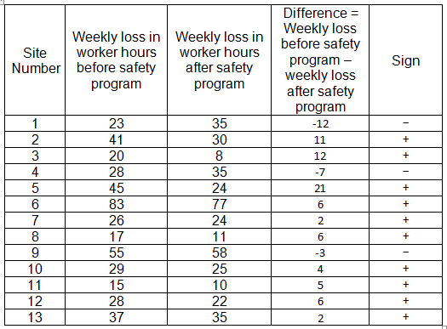
Example: Paired-sample Sign Test
[Solution]
The 13 sample pairs yield the following signs:

Slide 23
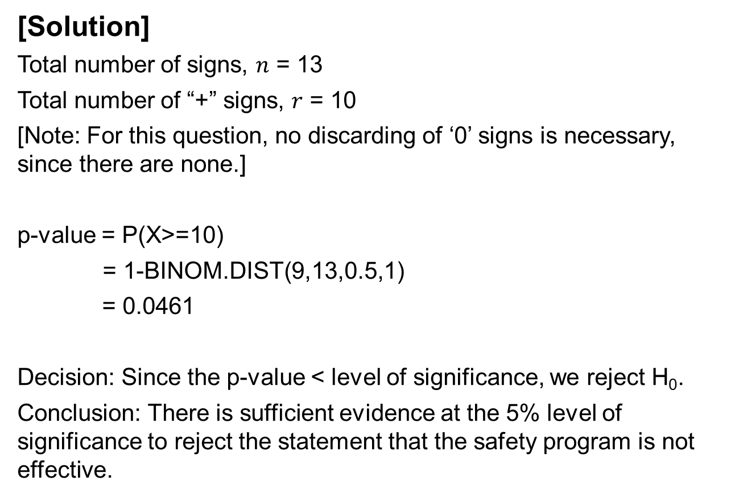
Example: Paired-sample Sign Test
[Solution]
Total number of signs, $n$ = 13
Total number of “+” signs, $r$ = 10
[Note: For this question, no discarding of ‘0’ signs is necessary, since there are none.]
p-value = P(X>=10)
= 1-BINOM.DIST(9,13,0.5,1)
= 0.0461
Decision: Since the p-value < level of significance, we reject H₀.
Conclusion: There is sufficient evidence at the 5% level of significance to reject the statement that the safety program is not effective.

Slide 24
Solving Scenario Tasks (B)
[Team discussion & activity]
From the scenario given earlier (slide 7), you are to help the researcher determine whether students’ travelling time from home to school in the morning is longer than the time they take to travel from school to home in the afternoon.
Consider the following:
State the hypotheses.
What is a suitable statistical test to conduct? What are the necessary assumptions? Decide on an appropriate level of significance.
Compute the p-value. Show all necessary working.
Can the null hypothesis be rejected? State a formal conclusion in the context of the scenario. Interpret the results.

Slide 25
Solving Scenario Tasks (B)
[Solution]

Slide 26
Solving Scenario Tasks (B)
[Solution]

Slide 27
Solving Scenario Tasks (B)
[Solution]

Slide 28
Kahoot! Quiz
Go to https://kahoot.it/ and enter the game pin shown by your lecturer.

Slide 29
Kahoot! Quiz
[Solution]

Slide 30
Learning Objectives
State the conditions for applying nonparametric tests
Perform a single-sample sign test for population median
Perform a paired-sample sign test for population median of differences

